Slide 1
Matthew 2:1-12
1After Jesus was born in Bethlehem in Judea, during the time of King Herod, Magi from the east came to Jerusalem 2 and asked, "Where is the one who has been born king of the Jews? We saw his star in the east and have come to worship him." 3 When King Herod heard this he was disturbed, and all Jerusalem with him. 4 When he had called together all the people's chief priests and teachers of the law, he asked them where the Christ was to be born.

Slide 2
Matthew 2:1-12
5 "In Bethlehem in Judea," they replied, "for this is what the prophet has written: 6 " 'But you, Bethlehem, in the land of Judah, are by no means least among the rulers of Judah; for out of you will come a ruler who will be the shepherd of my people Israel.' " 7 Then Herod called the Magi secretly and found out from them the exact time the star had appeared. 8 He sent them to Bethlehem and said, "Go and make a careful search for the child. As soon as you find him, report to me, so that I too may go and worship him."

Slide 3
Matthew 2:1-12
9 After they had heard the king, they went on their way, and the star they had seen in the east went ahead of them until it stopped over the place where the child was. 10When they saw the star, they were overjoyed. 11On coming to the house, they saw the child with his mother Mary, and they bowed down and worshiped him. Then they opened their treasures and presented him with gifts of gold and of incense and of myrrh. 12And having been warned in a dream not to go back to Herod, they returned to their country by another route.

Slide 4
Characters of Christmas
Ordinary People with Extraordinary Roles
Phil Adams
12/12/21

Slide 5
Shepherds and Magi

Slide 6
The Characters so far
Zechariah and Elizabeth – good people with a Priestly heritage.
Mary – a young girl from a poor background chosen as the mother for the Son of God.
Joseph - a common carpenter, chosen to father the Son of God

Slide 7
Magi (from Matthew)
2 After Jesus was born in Bethlehem in Judea, during the time of King Herod, Magi from the east came to Jerusalem ² and asked, “Where is the one who has been born king of the Jews? We saw his star when it rose and have come to worship him.”
³ When King Herod heard this he was disturbed, and all Jerusalem with him. ⁴ When he had called together all the people’s chief priests and teachers of the law, he asked them where the Messiah was to be born. ⁵ “In Bethlehem in Judea,” they replied, “for this is what the prophet has written:
⁶ “‘But you, Bethlehem, in the land of Judah, are by no means least among the rulers of Judah; for out of you will come a ruler who will shepherd my people Israel.’”

Slide 8
⁷ Then Herod called the Magi secretly and found out from them the exact time the star had appeared. ⁸ He sent them to Bethlehem and said, “Go and search carefully for the child. As soon as you find him, report to me, so that I too may go and worship him.”
⁹ After they had heard the king, they went on their way, and the star they had seen when it rose went ahead of them until it stopped over the place where the child was. ¹⁰ When they saw the star, they were overjoyed. ¹¹ On coming to the house, they saw the child with his mother Mary, and they bowed down and worshiped him. Then they opened their treasures and presented him with gifts of gold, frankincense and myrrh. ¹² And having been warned in a dream not to go back to Herod, they returned to their country by another route.

Slide 9
Complete Contrasts
Shepherds
Living nearby
Message from the angels
Low in importance
Unskilled
Poor
Uneducated
Magi
Lived far away (in the East)
Message from the star
High in importance
Skilled
Rich
Educated

Slide 10
The Event that we Celebrate at Christmas is Simple and Clear
Jesus did not come for individuals or for groups with similar characteristics. Jesus’ coming was for everyone.

Slide 11
Indeed, Jesus tells us exactly this (as recorded in John).
¹⁶⁻¹⁸ “This is how much God loved the world: He gave his Son, his one and only Son. And this is why: so that no one need be destroyed; by believing in him, anyone can have a whole and lasting life. God didn’t go to all the trouble of sending his Son merely to point an accusing finger, telling the world how bad it was. He came to help, to put the world right again. Anyone who trusts in him is acquitted; anyone who refuses to trust him has long since been under the death sentence without knowing it. And why? Because of that person’s failure to believe in the one-of-a-kind Son of God when introduced to him.

Slide 12
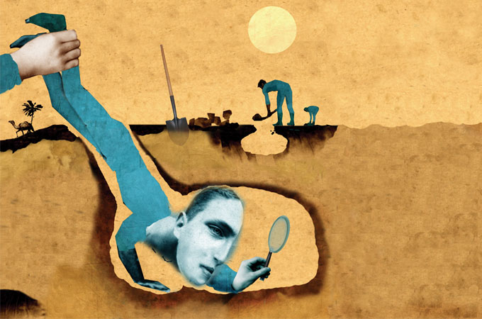
Shepherds

Slide 13
Shepherds – the situation
⁸ And there were shepherds living out in the fields nearby, keeping watch over their flocks at night. ⁹ An angel of the Lord appeared to them, and the glory of the Lord shone around them, and they were terrified.
Everyday people doing their work
Everyday people who like any people would be terrified by the sight of an Angel!

Slide 14
Shepherds – the situation
⁸ And there were shepherds living out in the fields nearby, keeping watch over their flocks at night. ⁹ An angel of the Lord appeared to them, and the glory of the Lord shone around them, and they were terrified.
This is the first announcement of Jesus’ birth to the rest of the world
Announced not to Kings or people in authority or to famous and prominent religious people
His birth was announced to ordinary people in an ordinary situation.

Slide 15
Shepherds – the sermon
¹⁰ But the angel said to them, “Do not be afraid. I bring you good news that will cause great joy for all the people. ¹¹ Today in the town of David a Savior has been born to you; he is the Messiah, the Lord.
The angelic sermon was one of Good News
Jesus is not to be feared. He is to give great joy for all.
“born to you”, a present reality not a future hope.
Bethlehem was the birthplace of David

Slide 16
Shepherds – the sign
¹² This will be a sign to you: You will find a baby wrapped in cloths and lying in a manger.”
The sign of the earthly stable
If you were looking for a King, where would you look?
(Actually you probably couldn't get past the guards)
If you did find a baby in a stable what would you think?
(Humility – “made lower than the angels” (Hebrews 2:9))

Slide 17
Shepherds – the Song
¹³ Suddenly a great company of the heavenly host appeared with the angel, praising God and saying,
¹⁴ “Glory to God in the highest heaven, and on earth peace to those on whom his favor rests.”
The sign of the Heavenly Song - contrasts
Stable speaks of humility. The song of heavenly riches.
Stable speaks of earth, the song of glory on high
Stable speak of a baby, the song of an all-powerful God.

Slide 18
Meeting Jesus
Receiving (they listened)
Directed(they searched)
Finding (they worshipped)
Responding (they told others)

Slide 19
Magi

Slide 20
Magi – who were they, where were they from and why did they come?
2 After Jesus was born in Bethlehem in Judea, during the time of King Herod, Magi from the east came to Jerusalem ² and asked, “Where is the one who has been born king of the Jews? We saw his star when it rose and have come to worship him.”
People who seek supernatural knowledge or ability.
From the East (end of story!)
They came with questions.

Slide 21
Complete Contrasts
Magi
Searched with excitement
Desired to worship
Filled with joy
Herod
Searched in fear
Desired to kill
Filled with rage

Slide 22
Star led their search to Jerusalem
Their search in Jerusalem led to Herod’s Palace
Star led them to Bethlehem

Slide 23
Who was your Star? Do you have Star responsibilities?

Slide 24
So what do we conclude?
The Grace of God is for everyone
But not everyone accepts

